Slide 1
CDC BREASTFEEDING SUPPORT INITIATIVE - Team Progress Report
We Didn’t Start the FHIR
Jamon Bowen, Justin Kristensen, John Van Wagenen, Philip Baxley, Zeyu Yang
Presented By: Jamon Bowen, Zeyu Yang

Slide 2
Project Overview – CDC Objective: Improve the Success of Mothers efforts to Raise a healthy BreastFeed Baby.
Identify data of Interest for initiating a lactation consultation referral and map to FHIR resources.
Enable easy collection of data from a patient of breastfeeding via a smartphone app.
Collect data from hospital EHR, pediatrician EHR, and patient reported data.
Display the collected data in a pediatrician EHR SMART app with clinical decision support to recommend and initiate a lactation consultation referral.

Slide 3
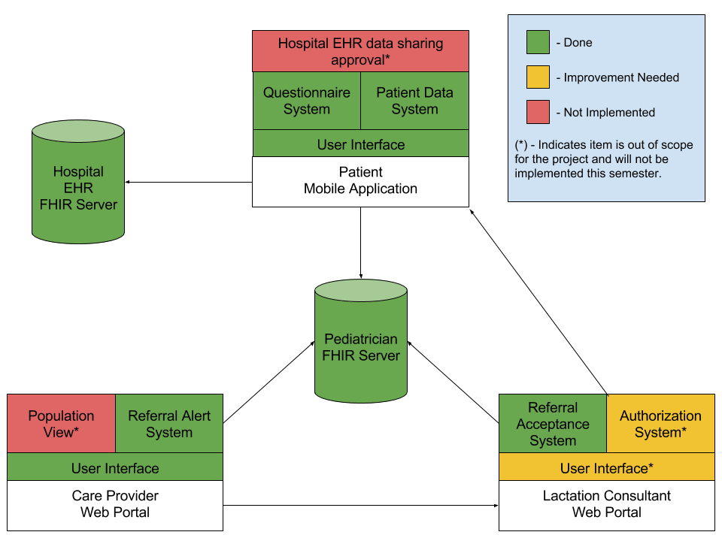

Slide 4
Hospital Data
Baby’s birth time – patient, _birthDate, extension, valueDateTime (in the babies patent record)
Baby’s birth weight – observation, vital-signs, Birth weight Measured (associated with baby)
Baby’s discharge weight - observation, vital-signs, Body weight Measured (associated with baby)
Mother’s risk factors:
Age - patient
Maternal obesity – BMI -observation, vital-signs, BMI (associated with mother)
Type I/II diabetes – Claim, diagnosis, diagnosisCodeableConcept (associated with mother)
Polycystic ovarian syndrome - Claim, diagnosis, diagnosisCodeableConcept (associated with mother)
Hyperthyroidism - Claim, diagnosis, diagnosisCodeableConcept (associated with mother)
Hypothyroidism - Claim, diagnosis, diagnosisCodeableConcept (associated with mother)
Mode of delivery – Claim, procedure, procedureCodeableConcept (associated with mother)
{
 | "resourceType": "Claim",
 | "type": "institutional",
 | "diagnosis": [
 | {
 | "sequence": "1",
 | "diagnosisCodeableConcept": {
 | "coding" : [
 | {
 | "system": "http://hl7.org/fhir/sid/icd-10",
 | "code": "E28.2",
 | "display": "Polycystic ovarian syndrome"
 | } ] }}],
 | "patient": {
 | "reference": "Patient?family=Cistica&given=Zora&birthdate=1985-01-01"
 | }}

Slide 5
Data collect for 30 Days (as Questionaire Response):
Date of survey data
Daily Breastfeeding metrics (average length, number of feedings, median interval, maximum gap)
Daily wet diaper counts
If the Mother's Milk has come in
If bowel movements have transitioned from Meconium to normal breastfeed baby bowel movements.
If mother signaled a concern

Slide 6
Referral Decision support:
Poor Daily Breastfeeding metrics
Low Daily wet diaper counts
If the Mother's Milk late.
If bowel movements not transitioning
Babies weight gain/loss
If mother signaled a concern

Slide 7
Demo

Slide 8
Team Roles: Project Manager – Jamon Bowen
iOS App – Justin Kristensen
Pediatrician SMART App – John Van Wagenen
FHIR backend & Test– Philip Baxley
Integration – Zeyu Yang
This initiative is a muilt-semester project. Left to do after Fall 2017 is improvements to the lactation consultant portal, a population view, and integration into production EHRs.

